Slide 1
Modern Justice
Belgium

Slide 2
Innovations in prison
NewAppEpi (Offender Management system)
Digital Platform for Inmates
VOIP Telephony in every cell
Videoconference

Slide 3
SidisSuite and NewAppEpi

Slide 4
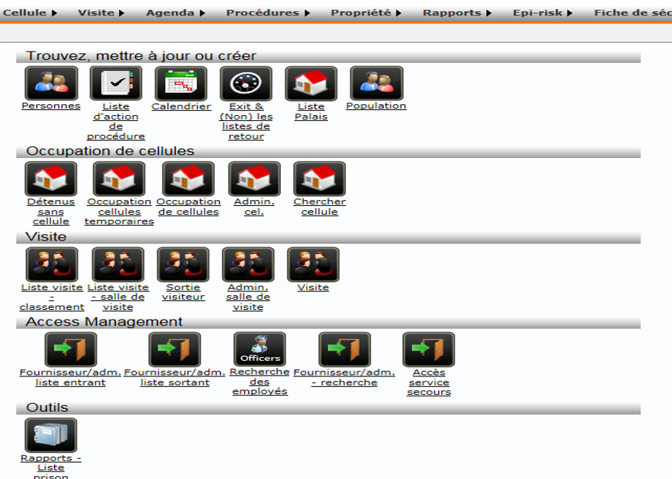

Slide 5
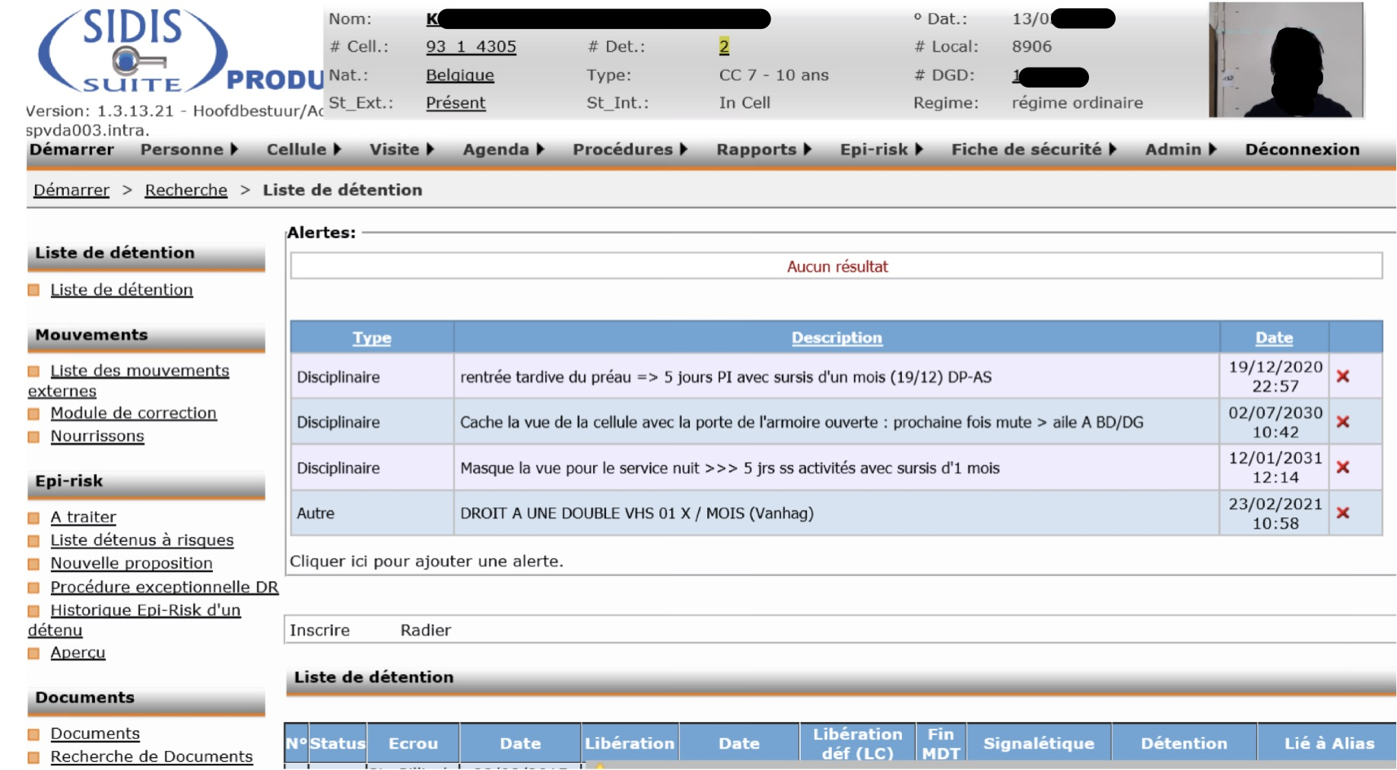

Slide 6
SidisSuite
Launched 2014
Every Inmates
Daily management of prisoners files
Gives info and help for daily work

Slide 7
NewAppEpi
Why do we need a new App ?
Among other things, because it lacks integration
With prisoner’s account
With Cellmade (prison’s work system)
Digitised court records

Slide 8
Digital platform for Inmates

Slide 9
Actual cell

Slide 10
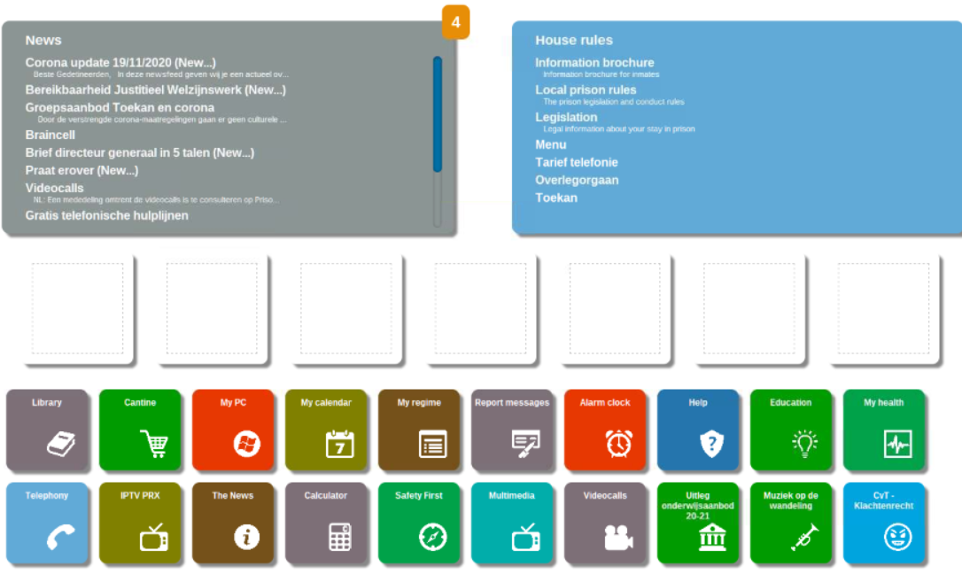

Slide 11
Digital platform for Inmates
Currently in three prisons (out of 34)
Television
Telephone
Canteen
Formations
Internal messaging system

Slide 12
Telephony in cell

Slide 14
Telephony in cell
Since 2019
About 90% of the inmates have access to it
VOIP + Power over Ethernet & UTPCables in the cell
Obviously to make calls but also
Checking their money balance

Slide 15
Vidéoconferences

Slide 16
Due to Covid19
Since May 2020
1 contact per week minimum
20 minutes per contact

Slide 17
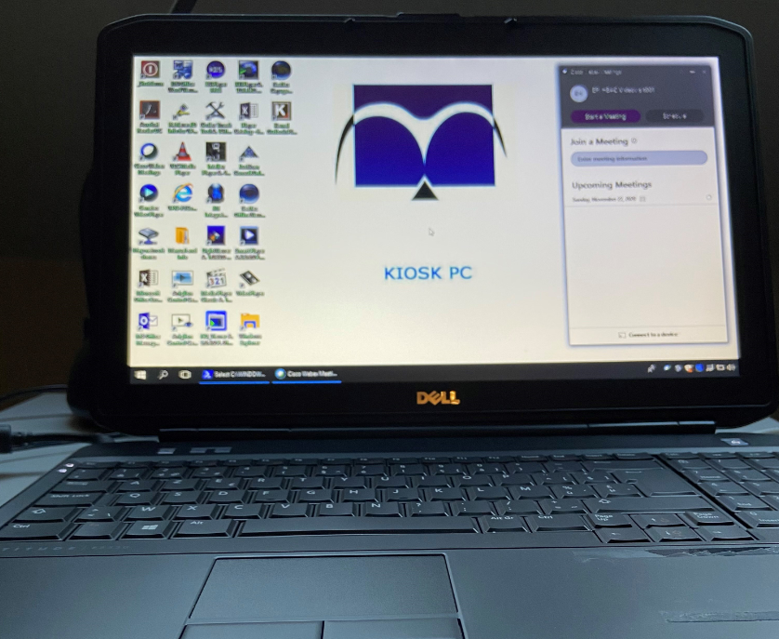

Slide 18
Consult-on-line
Ehealth - PacsOnWeb

