Slide 1
Enlisting Whistleblowers in the Fight Against Corruption
John Kostyack
National Whistleblower Center (USA)
24 November 2020

Slide 2
About the National Whistleblower Center

Slide 3
The National Whistleblower Center is a non-governmental anti-corruption organization, based in Washington, D.C, with a focus on:
Providing legal assistance to whistleblowers around the world
Advocating for strong whistleblower policy
Educating the public about the critical role of whistleblowers in safeguarding democracy and the rule of law

Slide 4
What is a Whistleblower?

Slide 5
Definition of a Whistleblower
A whistleblower is a person who:
Possesses information about serious wrongdoing that is generally unknown by the public
Discloses this information for the purpose of rectifying the wrongdoing
Information is typically disclosed to the government, media and/or employer

Slide 6
Whistleblowers: Essential Partners in the Fight Against Corruption

Slide 7
Whistleblowers are Essential
Addressing large-scale corruption, and securing meaningful penalties and/or jail time, requires powerful evidence
Those engaged in corruption are usually skilled at concealing their wrongdoing – e.g., using complex accounting, bribing public officials
Those inside corrupt institutions have access to well-hidden information and can interpret it

Slide 8
Retaliation: the Greatest Obstacle to Enlisting Whistleblowers as Partners

Slide 9
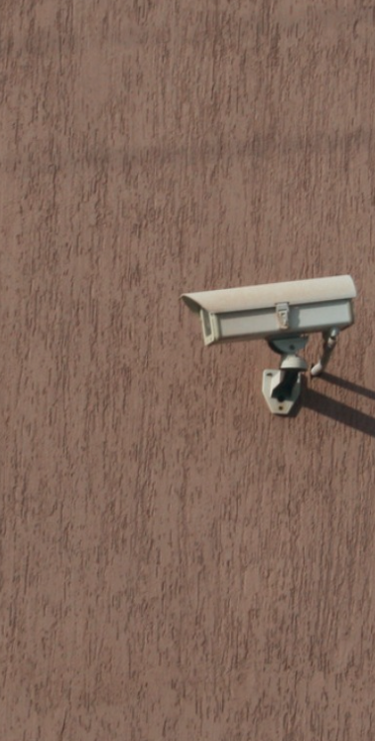
The Threat of Retaliation
Wrongdoers frequently destroy the lives and livelihoods of whistleblowers to stop and discredit them and to deter future whistleblowing
Those with access to information about large-scale corruption are often executives with much to lose if wrongdoers learn of their disclosures

Slide 10
Potential Whistleblowers are Watching
The widespread failure of government, corporations and the media to protect whistleblowers from retaliation is well-known to potential whistleblowers
Each new case of retaliation may be seen by potential whistleblowers as further evidence that disclosure is not worth the risk

Slide 11
Three Components of Successful Whistleblower Laws

Slide 12
Protecting and Incentivizing Whistleblowers
Effective anti-corruption programs include the following whistleblower protections:
Confidential reporting
A whistleblower office charged with investigating disclosures and using them to build cases
Guaranteed financial awards
The percentage of monetary sanctions provided to the whistleblower is linked to the whistleblower’s role in the successful outcome

Slide 13
Whistleblower Successes in the United States

Slide 14
U.S. Whistleblower Laws
The United States has over 50 whistleblower laws at the federal, state and local levels
Many have done a poor job protecting whistleblowers from retaliation; advocacy for stronger protections is needed
This presentation focuses on the most successful whistleblower laws, the ”reward” laws

Slide 15
Top Whistleblower Reward Laws
Dodd-Frank Act: fraud in connection with securities and commodities trading
Foreign Corrupt Practices Act: bribery of foreign officials
False Claims Act: fraud in connection with government contracting and permitting (includes customs fraud)
Internal Revenue Code: tax evasion and money laundering

Slide 16
The Success of U.S. Reward Laws
Since the False Claims Act was enacted in 1987, the government has recovered $438B and whistleblowers have received $6.4B
Since 2007, the IRS Whistleblower Office has collected $5.7B and awarded whistleblowers $932M
From 2011 to 2019, the SEC recovered $2B due to whistleblower disclosures and paid $387M to whistleblowers
From 2011 to 2017, 2,655 whistleblowers from 113 countries filed claims through the Foreign Corrupt Practices Act and over $40M has been paid to non-U.S. citizens

Slide 17
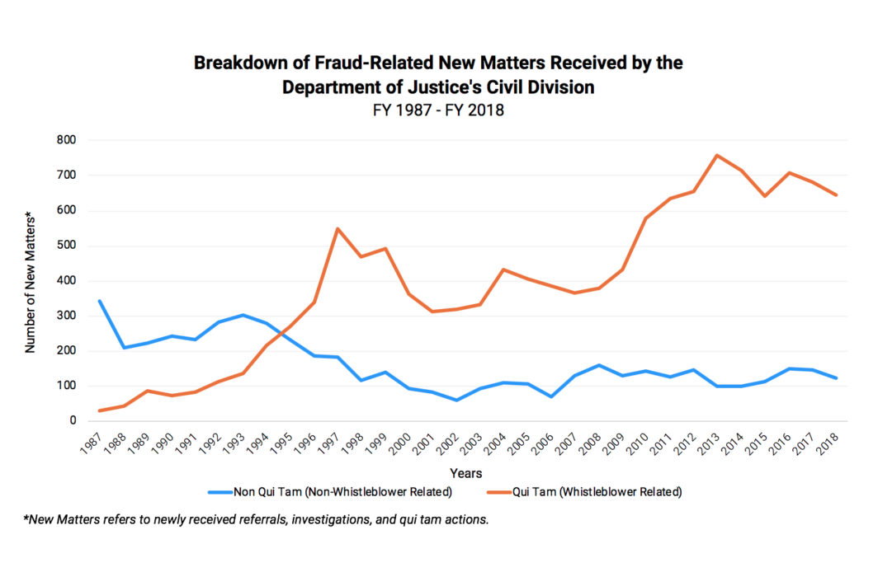
Whistleblowers are Vital to the U.S. Department of Justice's Civil Fraud Program

Slide 18
Praise for Whistleblower Laws from Law Enforcement Officials
“
[T]he False Claims Act has provided ordinary Americans with essential tools to combat fraud . . . their impact has been nothing short of profound.
— Former Attorney General Eric Holder, U.S. Department of Justice, remarks at the 25th anniversary of the False Claims Act (January 31, 2012).
The SEC “whistleblower program . . . has rapidly become a tremendously effective force-multiplier, generating high quality tips, and in some cases virtual blueprints laying out an entire enterprise, directing us to the heart of the alleged fraud."
— Chairman Mary Jo White, Securities and Exchange Commission, Remarks at the Securities Enforcement Forum, Washington DC (October 2013)
“

Slide 19
Why U.S. Whistleblower Laws Matter Outside the U.S.

Slide 20
Global Impact
As policy makers around the world consider ways to strengthen anti-corruption programs, they can draw lessons from U.S. whistleblower laws
U.S. whistleblower laws offer confidentiality and rewards to non-U.S. whistleblowers, even in cases against non-U.S. companies

Slide 21
Thank you for supporting whistleblowers!

